Slide 1

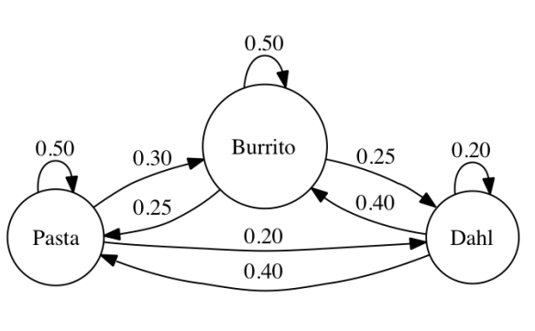
Workshop: Decision modelling in R Part 2
Stan Wijn MSc 22-03-2019

Slide 2
Today
Time-dependent probabilities
PSA
Any other?

Slide 3

Disclaimer
All information is based on the workshop hosted by the DARTH workgroup and my own experience.
If you use the pre-written code in your article, please cite there publication:
Jalal H, et al. An Overview of R in Health Decision Sciences. Med. Decis. Making. 2017; 37(3): 735-746.
Krijkamp EM, et al. Microsimulation modeling for health decision sciences using R: a tutorial. Med. Decis. Making. 2018; (in press).

Slide 4
General tips
Before you start, select a work-directory (to save your scripts)
Bottom-right, select Files tab and navigate to your folder. Then click More (gear icon in the top) and “set as working directory”
Assign variables using “<-” (shortkey alt and minus (-) )
Select multiple rows using alt + drag with mouse
Vocabulary:
Vector: a line of numbers (1,2,3,4,5,6) assigned using c(1,2,3,4)
Matrix: multiple vectors in a matrix structure (only one type: text, numeric)
Data.frame: matrix that can contain more then numbers (text)
Factor: Categorical variable

Slide 5
General tips
For PSA:
Use rnorm, rbeta, rgamma and for normal, beta and gamma resp.
rnorm(1, mean, sd)
rbeta(1, a, b)
rgamma(1, shape, scale)
Or rgamma(1, shape = mean^2 / sd^2, rate = mean / sd^2)

Slide 6
1. Time-dependent probabilities Markov models

Slide 7
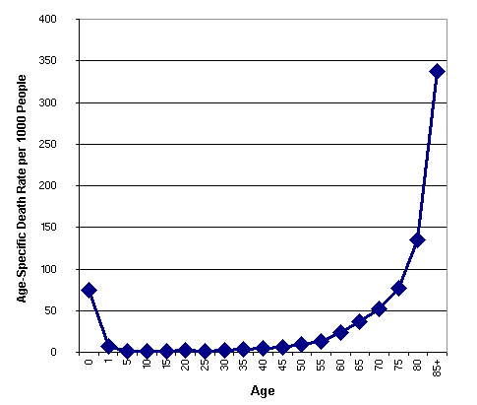

Slide 8
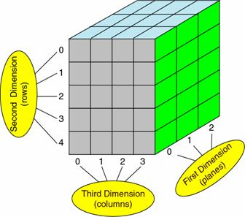
Cycle dependancies?
3D-array of transition probabilities
Cycles
To: health states
From: health states

Slide 9
R Session – Decision Tree https://github.com/StanWijn/DMIG
“Your dedication is inspiring!”

Slide 10
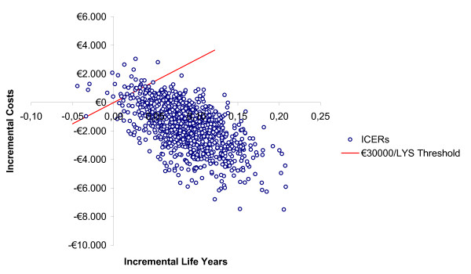
2. Probabilistic Sensitivity Analysis Markov models

Slide 11
4 Step of ‘default’ Markov
Model input
Define healthstates, probabilities, costs & effects
Initialization
Build empty Markov trace, build and fill transition matrix
Process
Run Markov model loop
Output
Calculate mean costs and QALY per cycle & discount

Slide 12
4 Step of ‘default’ Markov
Model input
Define healthstates, probabilities, costs & effects
Initialization
Build empty Markov trace, build and fill transition matrix
Process
Run Markov model loop
Output
Calculate mean costs and QALY per cycle & discount

Slide 13
4 Step of ‘PSA’ Markov
Function of input
Model input
Define healthstates, probabilities, costs & effects
Initialization
Build empty Markov trace, build and fill transition matrix
Process
Run Markov model loop
Output
Calculate mean costs and QALY per cycle & discount
Function of model

Slide 14
Function?
R has default functions (like rnorm, data.frame etc)
Functions are used to make code faster and easier to read
If you wrap code in a function it does not write any variables in your global environment (less variables)
Example:
firstfunction <- function(x,y){
x*2 + y*2
}
firstfunction(2,4) = 12

Slide 15
Functions
Functions are often ended with a return-command
If you run the command, you will receive what is put in the return line
Example:
Inputfunction <- function(n.sim = 1000){
df.psa <- data.frame(
p.HD = rbeta(n.sim, 20, 980),
p.SD = rbeta(n.sim, 100, 900)
)
return(df.psa)
}
Inputfunction(n.sim = 10)

Slide 16
7 Step of ‘PSA’ Markov
Define healthstates, cycle length etc.
Initialize input function
Initialize model function (initialize, run and output model)
Run input function n.sim-times (draws from distributions)
Initialize output matrix
Run model function with result from input function and write results in output matrix
Profit!

Slide 17
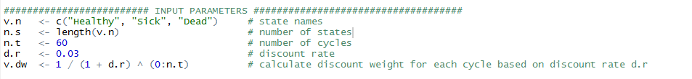
7 Step of ‘PSA’ Markov
Define healthstates, cycle length etc.

Slide 18
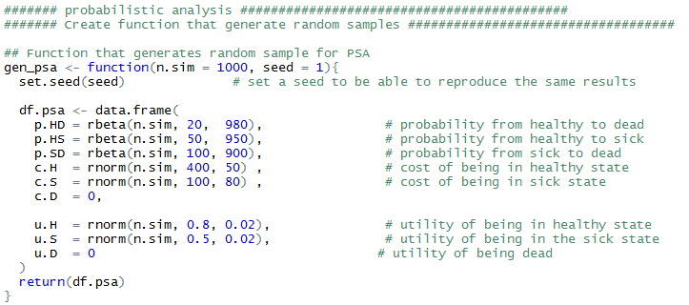
7 Step of ‘PSA’ Markov
Define healthstates, cycle length etc.
Initialize input function

Slide 19
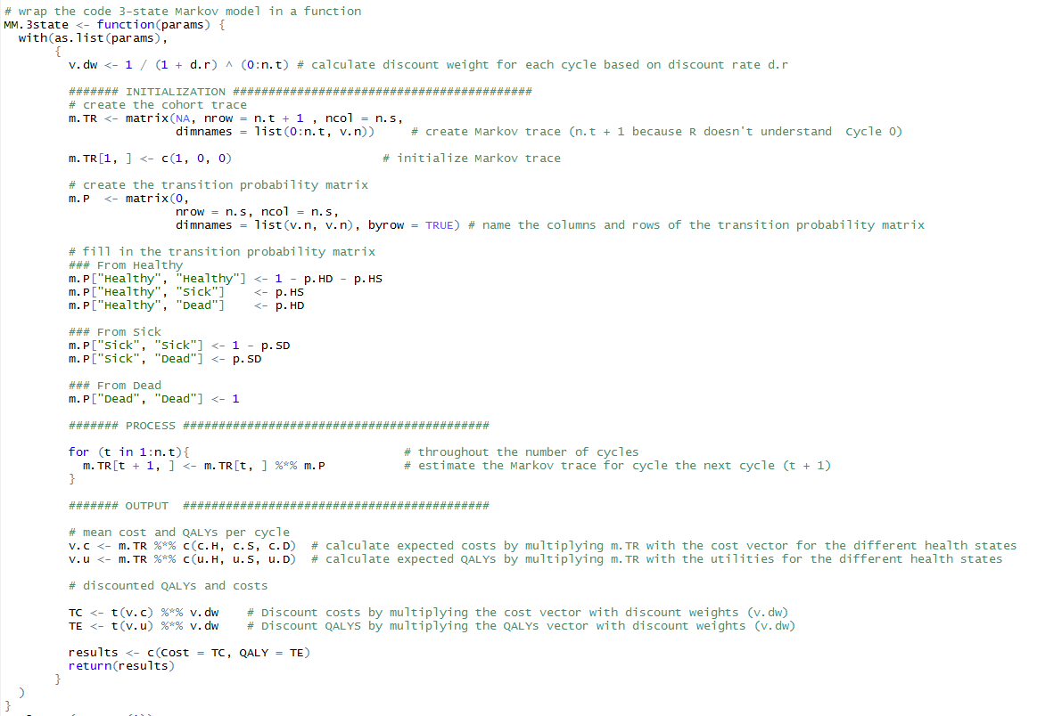
7 Step of ‘PSA’ Markov
Define healthstates, cycle length etc.
Initialize input function
Initialize model function (initialize, run and output model)

Slide 20

7 Step of ‘PSA’ Markov
Define healthstates, cycle length etc.
Initialize input function
Initialize model function (initialize, run and output model)
Run input function n.sim-times (draws from distributions)

Slide 21

7 Step of ‘PSA’ Markov
Define healthstates, cycle length etc.
Initialize input function
Initialize model function (initialize, run and output model)
Run input function n.sim-times (draws from distributions)
Initialize output matrix

Slide 22
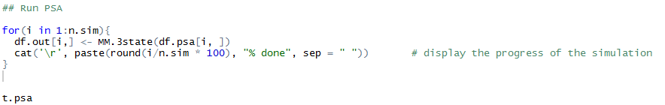
7 Step of ‘PSA’ Markov
Define healthstates, cycle length etc.
Initialize input function
Initialize model function (initialize, run and output model)
Run input function n.sim-times (draws from distributions)
Initialize output matrix
Run model function with result from input function and write results in output matrix

Slide 23
7 Step of ‘PSA’ Markov
Define healthstates, cycle length etc.
Initialize input function
Initialize model function (initialize, run and output model)
Run input function n.sim-times (draws from distributions)
Initialize output matrix
Run model function with result from input function and write results in output matrix
Profit!

Slide 24
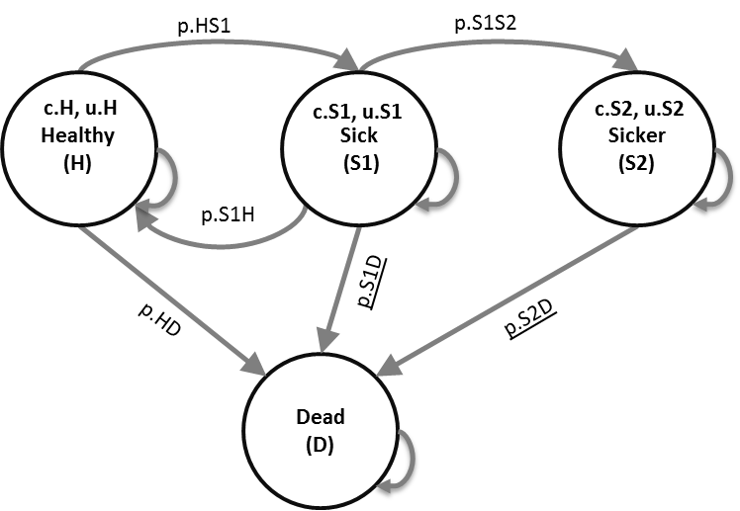
R Session – Markov Model https://github.com/StanWijn/DMIG

Slide 25
Literature:
Tutorial Microsimulation:
http://journals.sagepub.com/doi/full/10.1177/0272989X18754513
General overview of R modelling:
http://journals.sagepub.com/doi/abs/10.1177/0272989X16686559?url_ver=Z39.88-2003&rfr_id=ori:rid:crossref.org&rfr_dat=cr_pub%3dpubmed

Slide 26


